Slide 1
Python Libraries
(And how to use them!)

Slide 2
Libraries?
Let’s get a refresher!
Notes:
DEFINE WHAT A LIBRARY IS AND WHY PYTHON FREQUENTLY USES THEM

Slide 3
Libraries
pre-written code modules that can be used in your code to add functionality

Slide 4
What do libraries do?
They Make our lives easier!
They add an insane amount of tools!
Libraries allow you to do things like web scrape, create web apps, use AI, and do almost anything with code.
Could you imagine coding random, file input/output, or the square root function yourself?
There’s seriously a library for just about everything
Notes:
d3

Slide 5
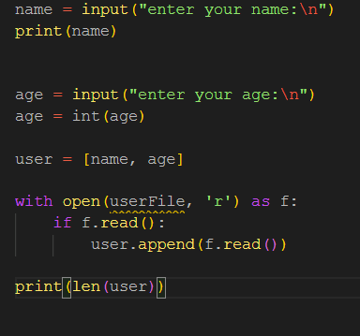
find the library functions!
Reminder: libraries allow us to do things we’d otherwise have to implement ourselves
Notes:
d3

Slide 6
Libraries do a lot more than just these basic functions!
Libraries with specific functionality have been built to make our lives easier in different ways:

Slide 7
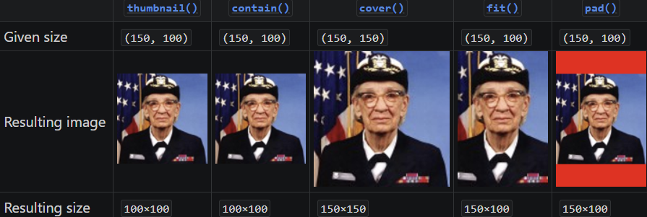
PIL (Python Imaging Library)
Now known as Pillow!
Allows for image manipulation such as:
File conversion (PNG -> JPG)
Image enhancement
Resizing (see 🐐)
Color transforms
https://pillow.readthedocs.io/en/stable/index.html
Notes:
DYLAN

Slide 8
Requests
“HTTP for Humans”
Requests is a simple HTTP library, “built for human beings”
Requests makes sending HTTP requests easy!
HTTP request - Hypertext Transfer Protocol Request
Requests data from a server
An http request is made every time you google something
Utility:
Web Scraping!
APIs & Data Science
Much More!
Notes:
d3

Slide 9

Spotipy
Simple Spotify interface library!
Allows access to:
Songs
Artists
Playlists
Genres
Followed artists
Example: https://github.com/spotipy-dev/spotipy/blob/master/examples/show_artist.py https://spotipy.readthedocs.io/en/2.22.1/#getting-started
Notes:
DYLAN

Slide 10


Flask / Django
Building Web Apps
As you might know, Flask is used to develop web apps with python!
Django is flask but different, it’s another library used for developing web apps with python
Notes:
d3

Slide 11
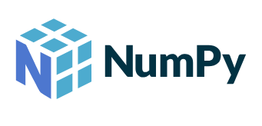
NumPy
Popular math/scientific library!
Allows access to:
Complex array operations
N-Dimensional arrays
Instead of multiplying element by element, just multiply the arrays!
This may sound basic, but many scientific libraries use NumPy to work their magic!
https://numpy.org/devdocs/user/absolute_beginners.html

Slide 12

Pandas
Pandas is a data analysis library
Working with HUGE datasets
analyzing, cleaning, exploring, and manipulating data
Utility:
Using requests to scrape data from an API
Use pandas to find correlations, organize, or clean data
Machine learning projects!
Notes:
d3

Slide 13
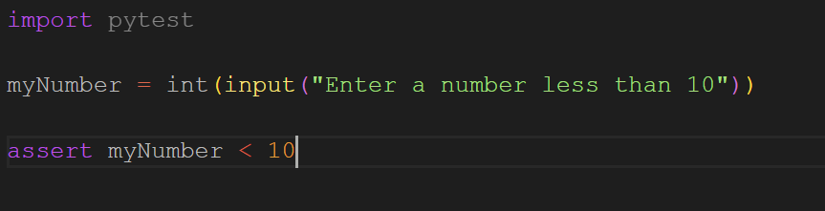
Pytest
Python library for testing code!
“Helps you write better programs”
Pytest makes it easy to add small, readable tests to your code.
Pytest is also very scalable!
Notes:
d3
What will happen if the number is greater than 10?

Slide 14

Beautiful Soup
HTML/XML data manipulation!
As easy as:
Getting links from that HTML:

Slide 15


Tensorflow / Scikit-learn
Two helpful machine learning libraries!
These libraries make machine learning a lot easier!
easily loading data and creating input pipelines
built-in functions for complicated ML math
built-in step-by-step tutorials for popular ML problems
The most popular python ML libraries
-> Resources are ubiquitous
Notes:
d3

Slide 16
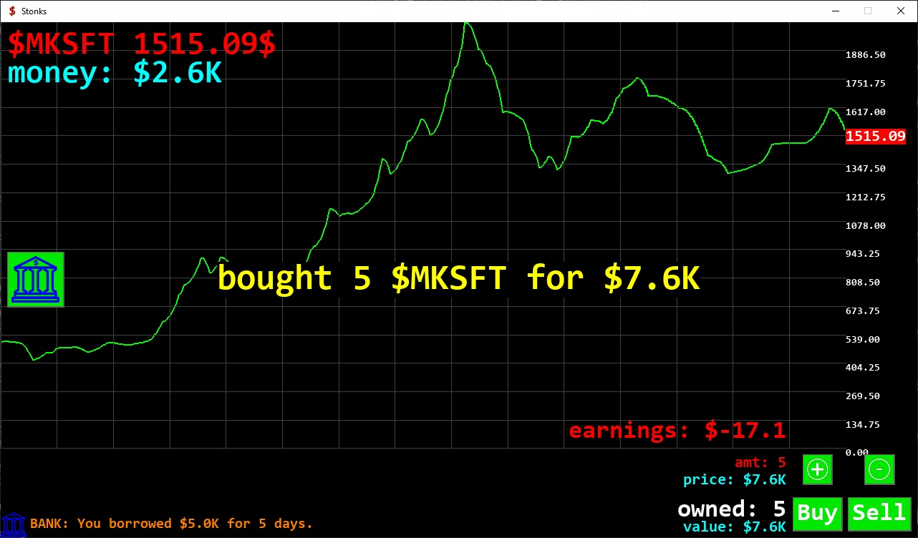

Pygame: 2D Games
https://www.pygame.org/wiki/GettingStarted
Interfaces with SDL!
Pictured: $STONKS Simulator
https://stonks.markop1.cz

Slide 17
Happy coding!
https://replit.com/@delster1/libdemo#gettingstartedlibs.py

